Slide 1
GIT/Github day 2
May 1st, 2024

Slide 2
Recap day 1
Do the course survey!!!
Made a new repo under your account
Explored some ways to see changes (diff) between working copy and the repository
Finish setting up SSH keys (4pts on this week’s homework)
Added to keychain or ssh-agent
Uploaded to github
Change remote URL on my-resources
In RStudio Terminal tab, do:
git remote set-url origin git@github.com:meekrob/my-resources.git
Now click the up-arrow to push!!!

Slide 3
ChatGPT, why do we add our key to the ssh-agent?
Convenience: The SSH agent is a background process that runs on your local machine and holds your decrypted private keys in memory. By adding your private key to the SSH agent, you can avoid having to enter your passphrase every time you use your private key. Once your key is added to the agent, it can be used for authentication without needing to re-enter the passphrase for that session.
Security: While using an SSH passphrase adds an extra layer of security by encrypting your private key, typing it in every time you need to use the key can be cumbersome and might lead users to choose weaker passphrases or even forgo using one altogether. By storing the decrypted key in the SSH agent, you can use a strong passphrase without the hassle of typing it repeatedly.
Key Management: The SSH agent makes it easier to manage multiple SSH keys. Instead of manually specifying which key to use for each connection or operation, the SSH agent automatically selects the appropriate key based on the server or service you're connecting to.
Lifetime Management: When you add a key to the SSH agent, you can specify how long the agent should keep the key in memory before automatically expiring it. This adds an extra layer of security by limiting the window of opportunity for an attacker to misuse the key if they gain access to your machine.

Slide 4
Work on your my-resources repo
In RStudio
Add examples/ directory and files (Final project 5 pts)
Add templates/ directory and files (Final project 5 pts)
Note: You can’t add empty directories to repositories
Find a partner
Add as collaborator under your repo’s github.com settings (Homework 2pts)
Contribute one of your resources to their repository (Homework 4pts: see below)
On github.com, go to their repository
Create a new branch: “yourname’s resource”
Upload your resource to their examples or templates directory
Submit pull request (Homework 2pts)
Accept partner’s pull request (Homework 2pts)
Merge and Delete the extra branch
See Network under “Insights”

Slide 5

Making changes on github AND your local copy
Ernie’s repo
Ernie makes a commit from the github website
1
2
3
Main branch (on github)
clone
push
push
pull
Ernie’s Local copy of main as an RStudio project
[initial commit]
Commit 1
Commit 2
Commit 3: up to date on Ernie’s computer

Slide 6
Branching (Ernie gets bolder)
Ernie’s repo
Try some new stuff “development” branch
Create branch
X
Delete branch
5a
5b
*
4
5
6
Main branch (on github)
…
The main branch is “stable”
Make a merge commit
Note- commit numbers are for demonstration only

Slide 7

Collaborating
Repository owner
Collaborator: Bert (write permission)
8_{bert}
Bert’s commit(s)
X
Delete branch
Bert creates branch
*
Pull request
7
8
9
…
Ernie makes Commit 9:
Merge (Bert-> main)

Slide 8
The Whole commit history as a Graph/Network
Repository owner
Collaborator: Bert (write permission)
Ernie’s development branch
8_{bert}
Bert branch
x
x
5a
5b
*
*
1
2
3
4
5
6
7
8
9
[initial commit]

Slide 9

Time to roleplay Bert and Ernie
You find a partner
Add as collaborator under your repo’s github.com settings (Homework 2pts)
(You will also be their Bert to their Ernie)
Contribute one of your resources to their repository (Homework 4pts: see below)
As their
On github.com, go to their repository
Create a new branch: “Bert’s resource”
Upload your resource to their examples or templates directory
Submit pull request (Homework 2pts)
As
Accept partner’s pull request (Homework 2pts)
Merge and Delete the extra branch
See Network under “Insights”
https://www.deviantart.com/mooncreeper

Slide 10
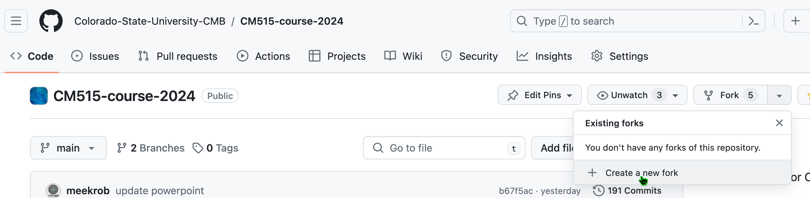
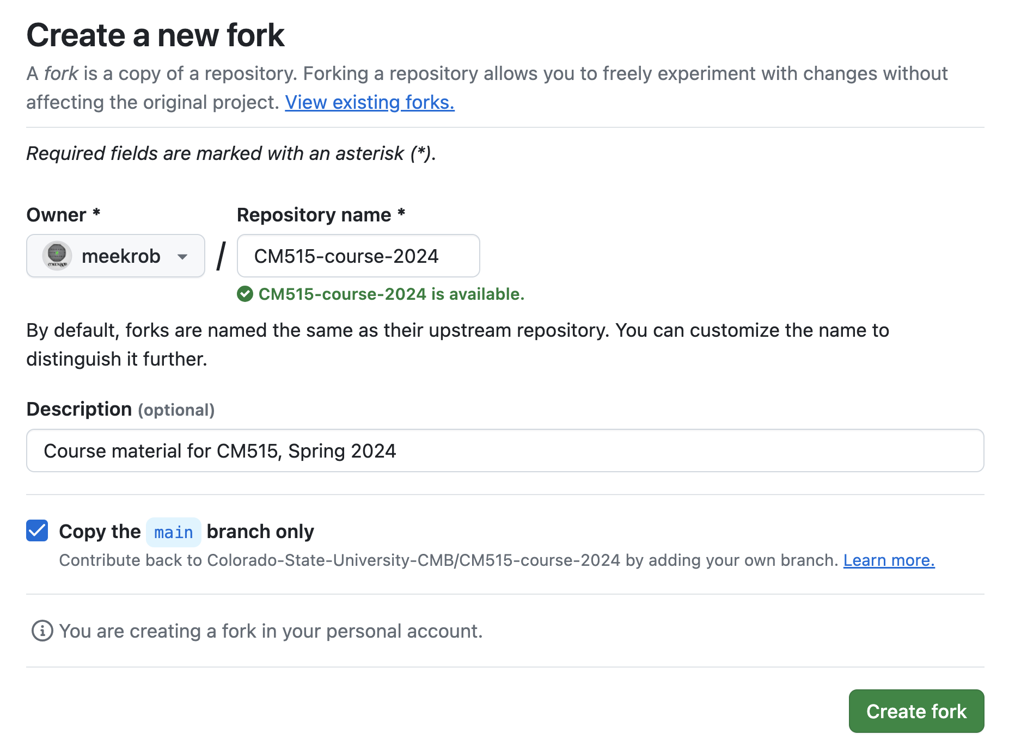
Forking
Go to https://github.com/Colorado-State-University-CMB/CM515-course-2024

Slide 11
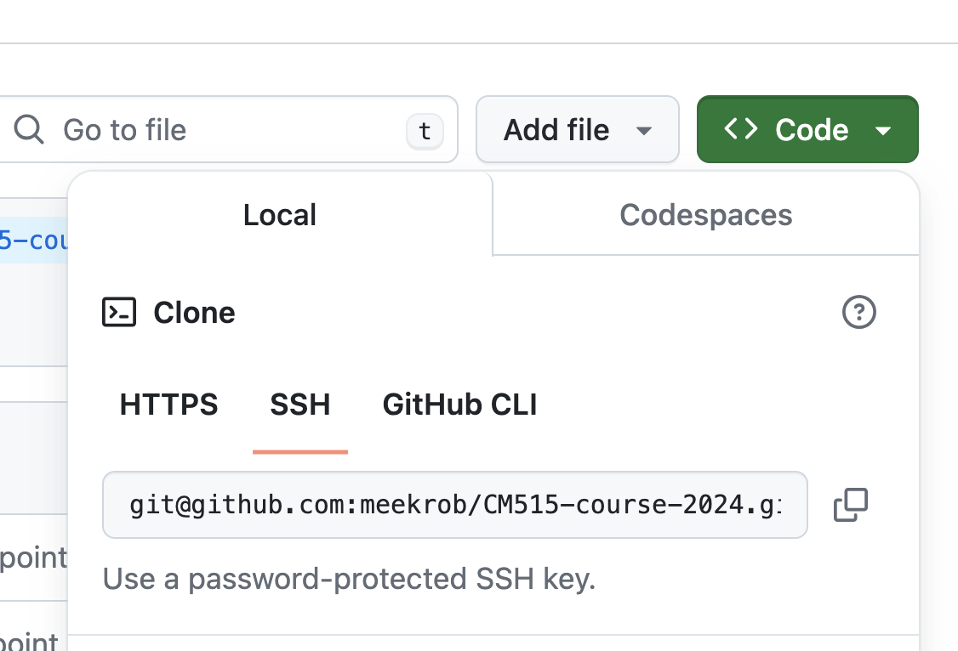
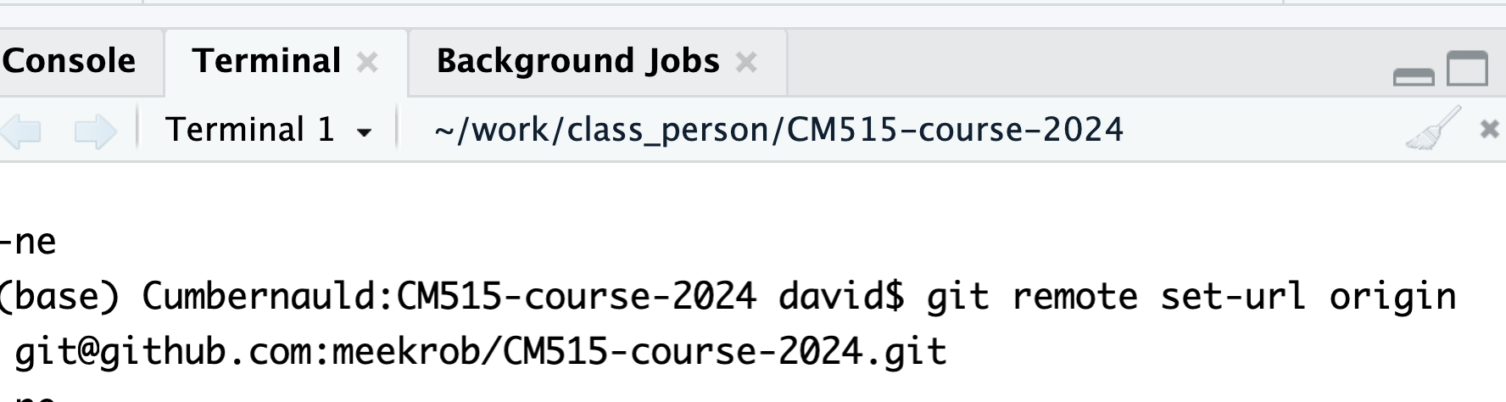
Get YOUR fork of class repo into RStudio
1
Change your url in RStudio like we did for my-resources
2
git remote set-url origin git@github.com:meekrob/CM515-course-2024.git
3
Type this command in your terminal (replace my username with yours) and hit return
If this doesn’t work, create a new project linked to this repository

Slide 12
What to do for final project in the fork
Your version of the CM515 repo
Fork class repo 5pts
Save some completed assignments in your repo. You must do this for at least two modules. 5pts
Add, commit and push an assignment file from at least TWO different modules
WHAT TO TURN IN: Nothing. We will check to see your commit history to see that you added two files.

Slide 13
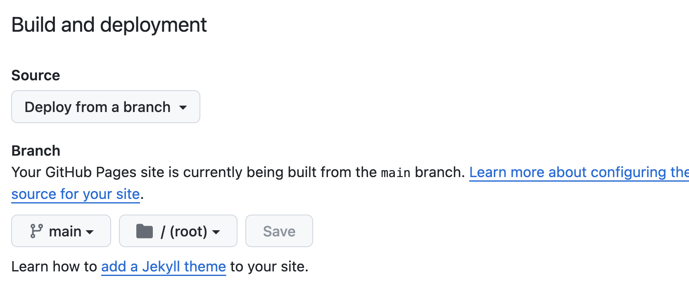
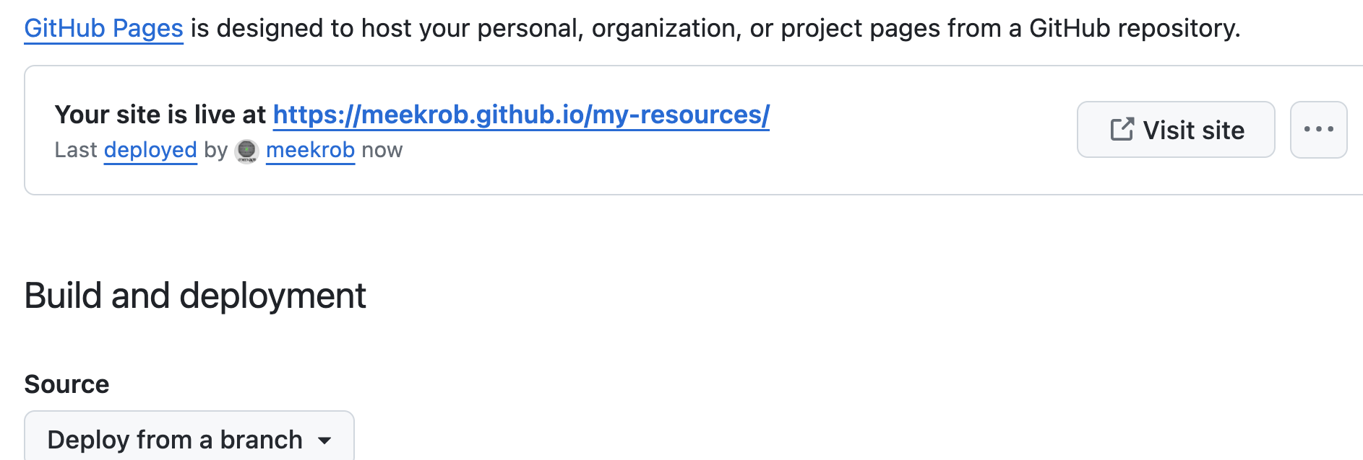
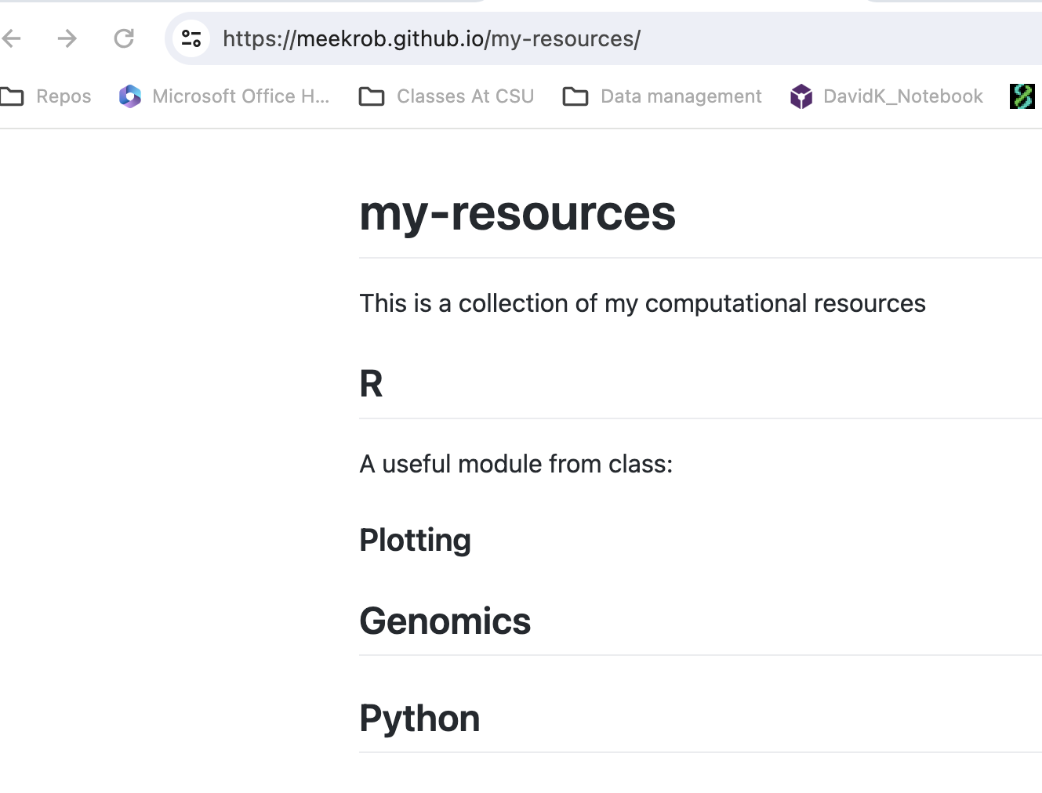
Github pages
In repository settings, the link “Pages” is on the left side
This appears after a minute
Now I have a website for the my-resources repository. You don’t need to do this: it’s for demonstration.
The contents of the website are rendered from the markdown in README.md

Slide 14
Your profile
Create a new repository that’s the same as your github username
It is a special repository with a README.md that renders html onto your github.com/username page
Use the markdown guide to fullfill the requirements of the final project
Your portfolio
Make a special repository with the same name as your username. This will be the "profile" repository for your account. 5pts
Turn on github pages for your profile. It will build a website for you at https://username.github.io/username/. 5pts
What to put in your portfolio (this is the README.md on your portfolio's repo)
An introduction to yourself. 5pts
On your portfolio's front page, create a "useful links" link that goes to your my-examples repo. Use the markdown referenceLinks to an external site. for this. 5pts
On your portfolio's front page, create an "interesting" module link that goes to a module in your fork of the class repo. 5pts

Slide 15
Have. At. It.

